Slide 1

Machine Learning Group Project
Scene-Centric Image Recognition Task with SUN397 dataset
Xiang WANG 1106943
Ao Chen 1123154

Slide 2
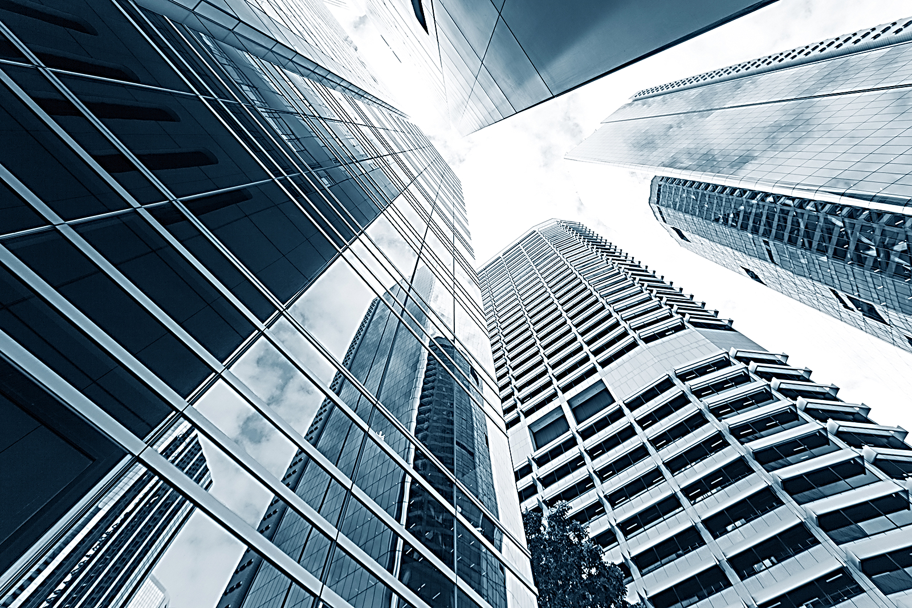
1
Introduction
CONTENTS
2
Methodology
3
Experiment
4
Result

Slide 3
Introduction
· Pre-processing SUN397 dataset
· Using Sun397 Dataset , which is the scene image dataset
· Using variety of DCNN structures such as VGG16 DenseNet121 DenseNet 201

Slide 4
Methodology
pre-processing dataset
VGG16 model
DenseNet 121
DenseNet 201

Slide 5
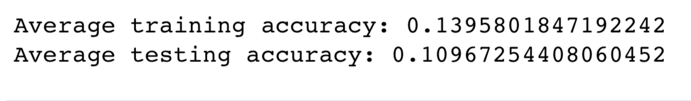
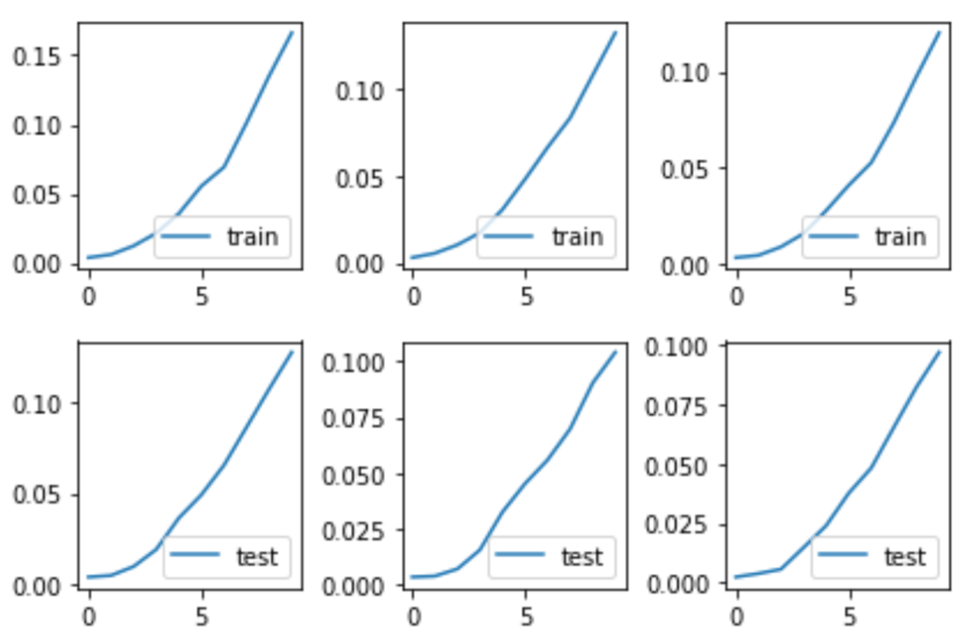
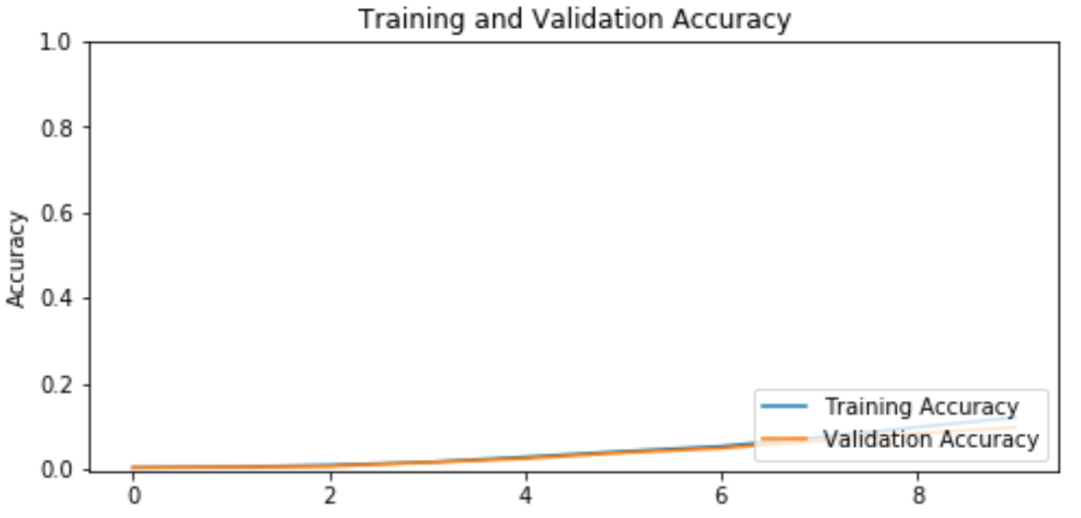
Results
VGG16 based on imagenet weights

Slide 6

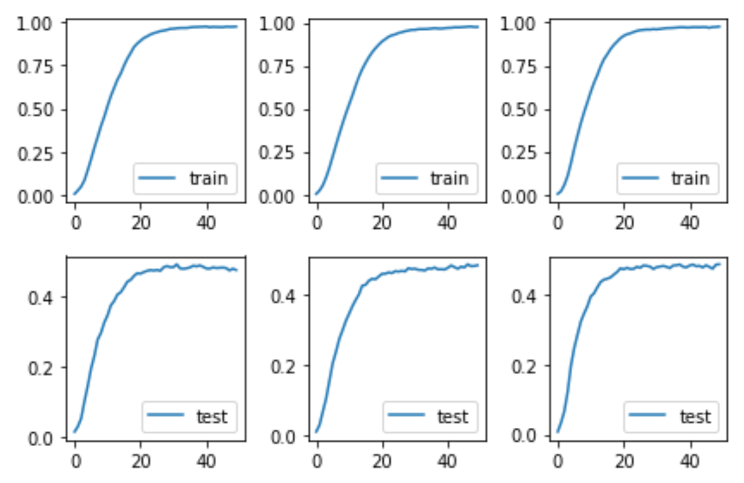
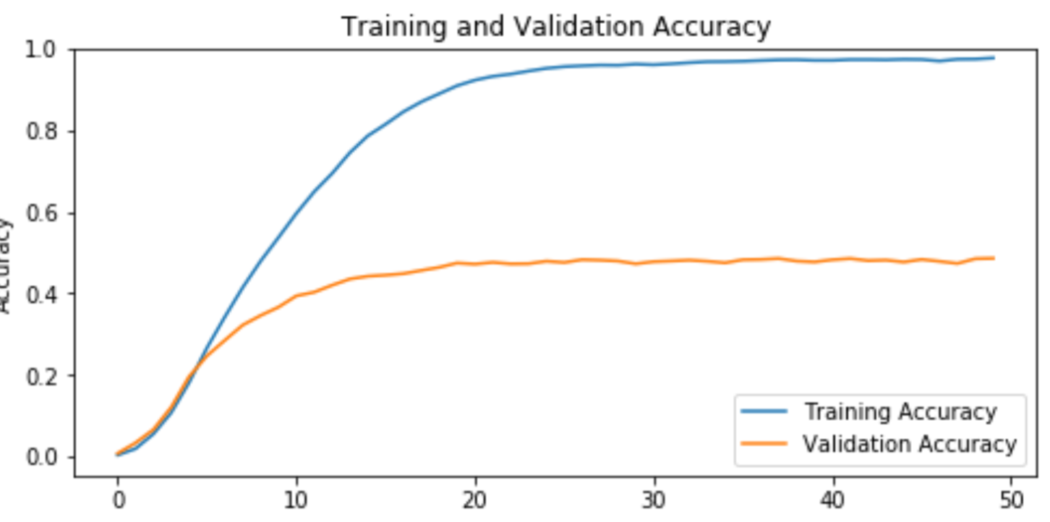
Results
VGG16 based on places365 weights

Slide 7
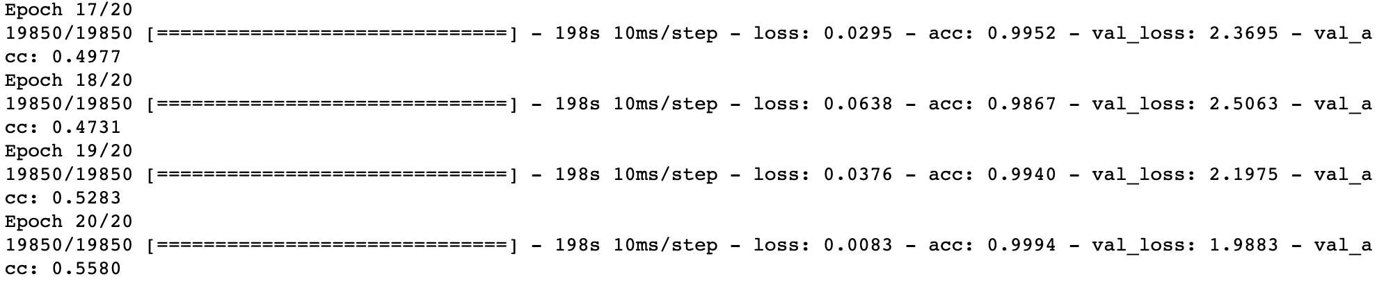
Results
DenseNet 121 based on imagenet weights

Slide 8
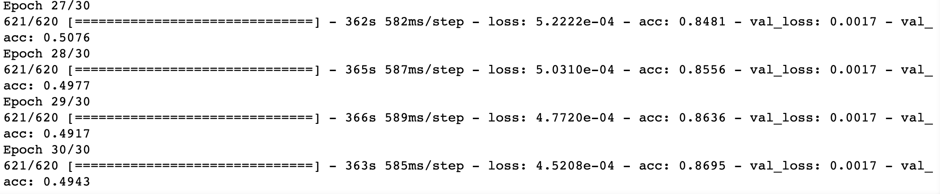
Results
DenseNet 121 based on imagenet weights with Data generation

Slide 9
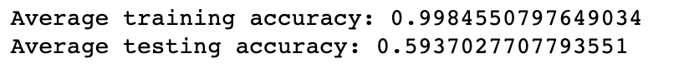
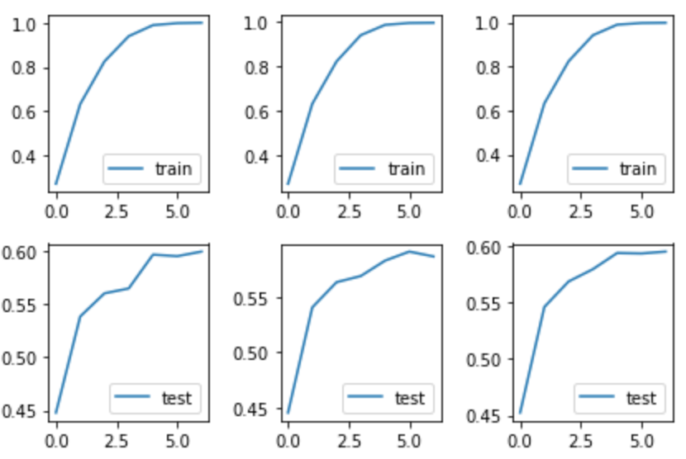
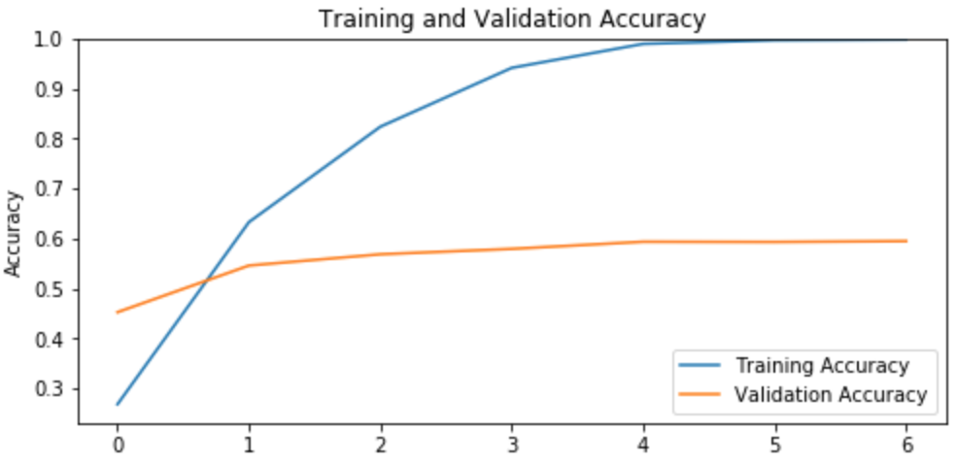
DenseNet201 based on imagenet weights

